Slide 1

Sports Analytics NHL-2.0
Presenter Names:
Ravina Kolsawala
Ron Brennan
Gosaye White
Ghislain Nyirumuheto
Joel Demontigny
Date: August 9, 2023
© Copyright Showeet.com
Notes:
© Copyright Showeet.com – Free PowerPoint Templates

Slide 2
Agenda:
Introduction:
- Background
- Data and Resources
Team statistics comparison
Team statistics information
Goalie statistics
© Copyright Showeet.com
Notes:
© Copyright Showeet.com – Free PowerPoint Templates

Slide 3

Background:
For this project version, we are focused on providing the best visuals representing data related to Stanley Cup winning teams over the last 30 seasons. We are providing an enhanced user experience by creating an interactive dashboard that will enable the end user to select various filters to analyze and compare data from each winning team over the course of the last 30 seasons vs the rest of the league, or for informative purposes to analyze player statistics. The basis of this project, is the evolution of our initial data gathering and analysis on this topic which can be found here: (https://github.com/rbrennan55/project-sports-analytics-NHL.git).
(The NHL and the NHL Shield are registered trademarks of the National Hockey League. NHL and NHL team marks are the property of the NHL and its teams. © NHL 2023. All Rights Reserved.)
Notes:
© Copyright Showeet.com – Free PowerPoint Templates

Slide 4
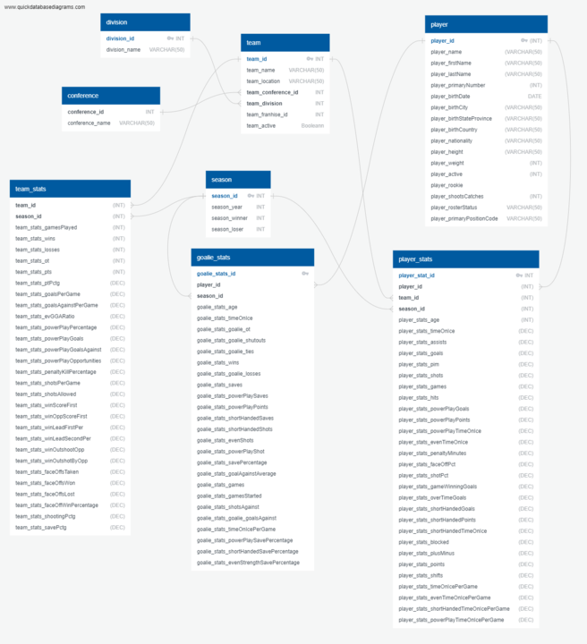
Data and Resources:
Notes:
© Copyright Showeet.com – Free PowerPoint Templates

Slide 5
Data and Resources:
Team Stats per season:
API Call: https://statsapi.web.nhl.com/api/v1/teams
Roster per team per season:
API Call: https://statsapi.web.nhl.com/api/v1/teams/<Team ID>?expand=team.stats&season=<season>
Player Stats per season:
API Call: https://statsapi.web.nhl.com/api/v1/teams/<Team ID>?expand=team.roster&season=<season>
Player Stats year by year season:
API Call: https://statsapi.web.nhl.com/api/v1/people/<Player ID>/stats??stats=statsSingleSeason&season=<season>
Notes:
© Copyright Showeet.com – Free PowerPoint Templates

Slide 6
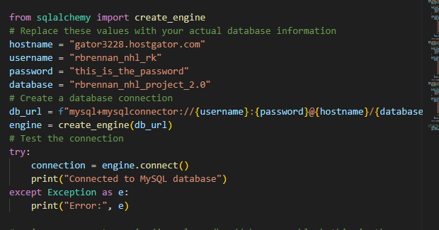
Data and Resources:
Notes:
© Copyright Showeet.com – Free PowerPoint Templates

Slide 7
Player’s birth city
Select the season and see the players birth city on the world map!
© Copyright Showeet.com
Notes:
© Copyright Showeet.com – Free PowerPoint Templates

Slide 8
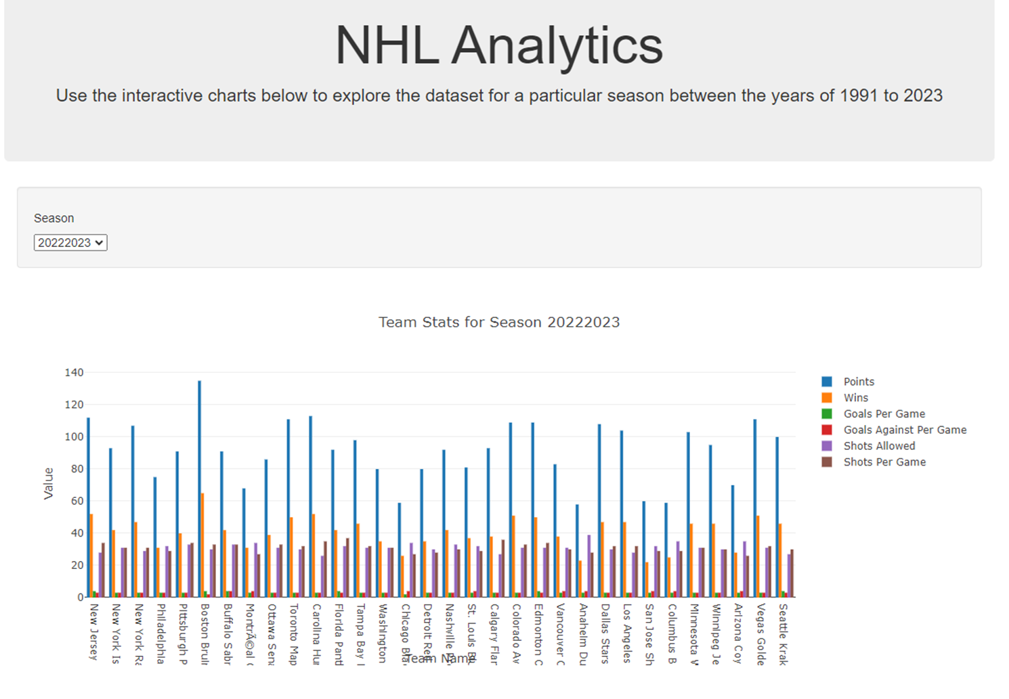
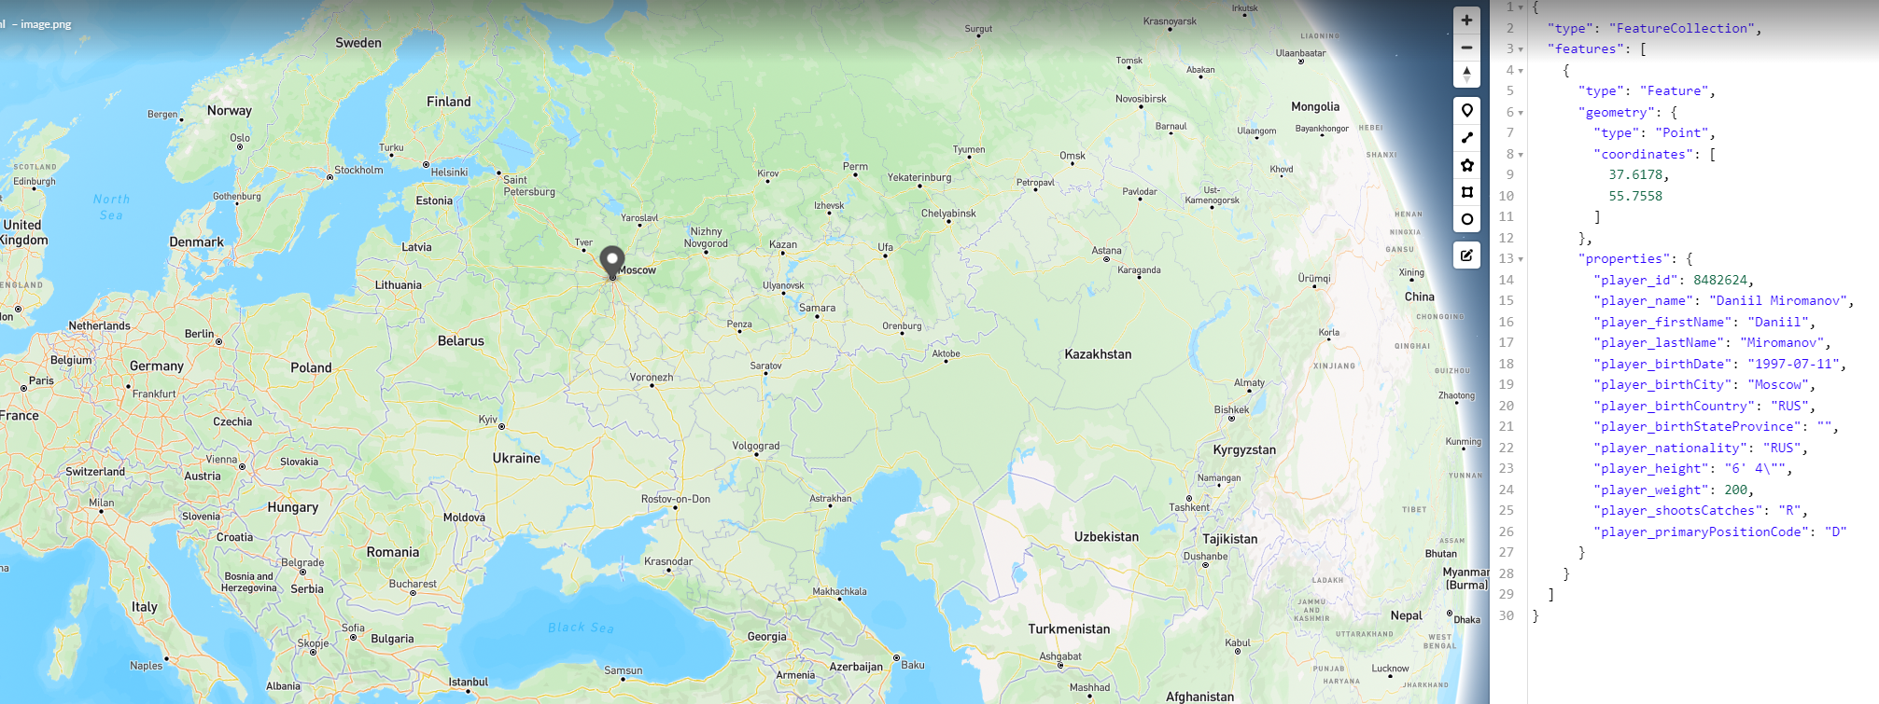
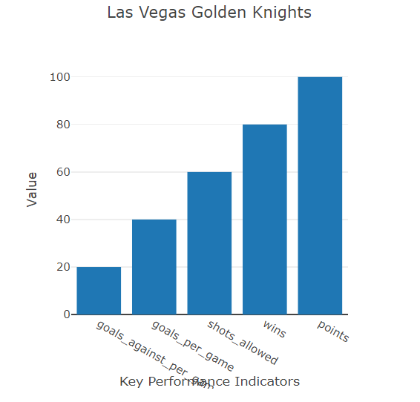
Notes:
© Copyright Showeet.com – Free PowerPoint Templates

Slide 9
Stanley Cup winning team
Select the season and see statistics specifically on the Stanley Cup winning team’s performance!
© Copyright Showeet.com
Notes:
© Copyright Showeet.com – Free PowerPoint Templates

Slide 10
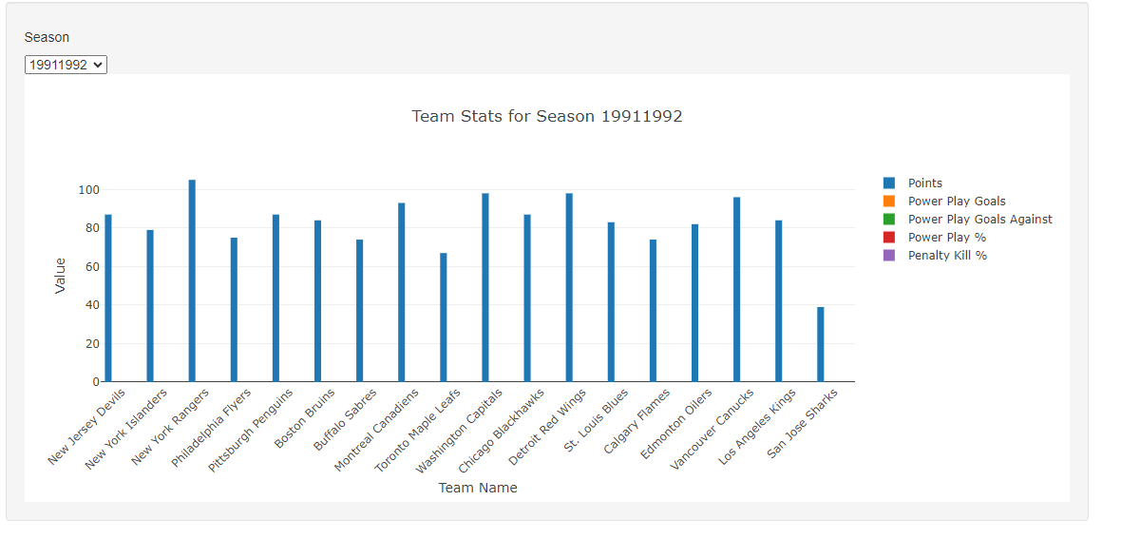
Notes:
© Copyright Showeet.com – Free PowerPoint Templates

Slide 11
Team comparison
Select the season to see winning team’s statistics vs the overall team averages for that same season!
© Copyright Showeet.com
Notes:
© Copyright Showeet.com – Free PowerPoint Templates

Slide 12

Notes:
© Copyright Showeet.com – Free PowerPoint Templates

Slide 13
Goalie statistics comparison
Select the season to see the winning goalie’s statistics vs those of his competitors for that same season!
© Copyright Showeet.com
Notes:
© Copyright Showeet.com – Free PowerPoint Templates

Slide 14
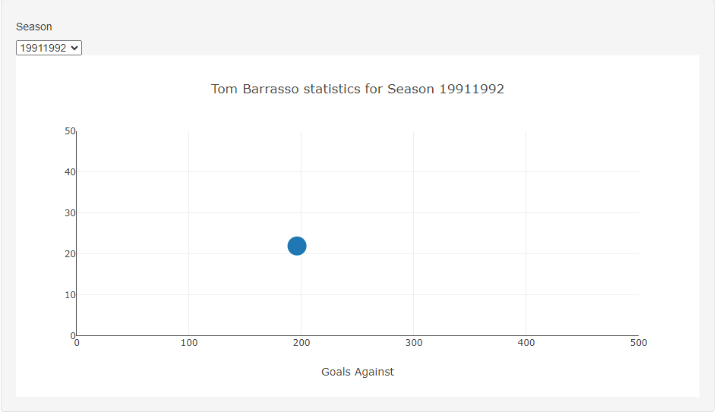
Notes:
© Copyright Showeet.com – Free PowerPoint Templates

